Slide 1
Advanced FTC Code
panic!
https://github.com/JimWright4089/FIRSTWorkshops

Slide 2
Intro
Things covered in this class:
Andriod Studio
Getting the code
FTC dashboard
FTC Road Runner

Slide 3
Andriod Studio
A lot more complicated than OnBoard Java
A lot more flexible as well.
A good tool to know

Slide 4
Android Studio Setup
Download/Install JDK
https://www.oracle.com/java/technologies/downloads/
Download/Install Android Studio
https://developer.android.com/

Slide 5
FTC Project
Github has it.
https://github.com/FIRST-Tech-Challenge/FtcRobotController
You can download and use it from Github.
Better to fork the code into your Github project. This lets your team check in code.
Clone this project onto your hard drive.

Slide 6
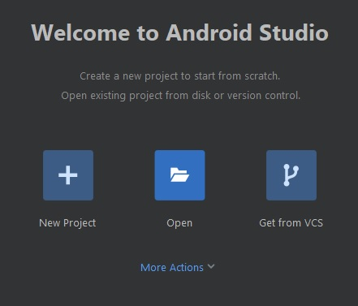
FTC Project
In Android Studio choose open.
Find the cloned project, it will have a little Andriod symbol on it.
It will take a while, to get the code and all of the libraries loaded the first time.

Slide 7
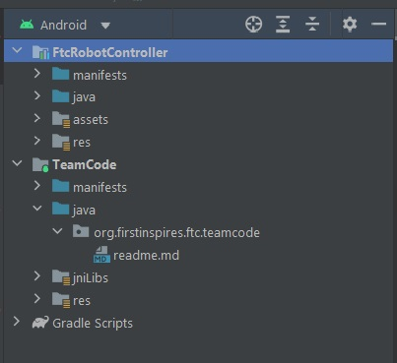
Your Code here!
Once everything is loaded, the explorer will be on the left.
Open up the Team Code directory.

Slide 8
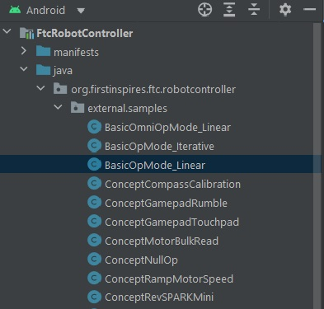
Samples
In the example folder there are, well, examples of code. Copy those to your Team code.

Slide 9
FTC dashboard
The FTC dashboard acts like the FRC dashboard.
It is a panel that lets you see what your robot is doing.
It’s not official.
https://acmerobotics.github.io/ftc-dashboard/

